Slide 1
FLOOD ALERT SYSTEM
Guided By :
Mrs: LALITHA K
PRESENTED By :
PRADEEP KUMAR PATEL T(22AI034)
TAMILMANI E(22AI053)
TEAM NO : 17
22AIP10 &INTERNET OF THINGS LABORATORY

Slide 2
Abstract
Flooding poses a significant risk to communities worldwide, necessitating efficient early warning systems to mitigate its impacts. This abstract presents a comprehensive flood alert system designed to enhance real-time monitoring and response. The system integrates various data sources, including meteorological forecasts, river gauges, and historical flood data, to provide timely and accurate alerts. Utilizing advanced algorithms and machine learning techniques, it predicts potential flood events and assesses risk levels. The system employs a multi-channel notification approach, disseminating alerts via mobile to ensure widespread awareness.

Slide 3
Objectives:
Early Detection and Prediction
Timely Alerts and Notifications
Risk Assessment and Management
Continuous Improvement and Adaptation

Slide 4
Components Required:
1. Arduino Uno
2. GSM SIM 800 C Module
3. Water Level Sensor
4. Connecting Cable
5. 12V Adapter

Slide 5
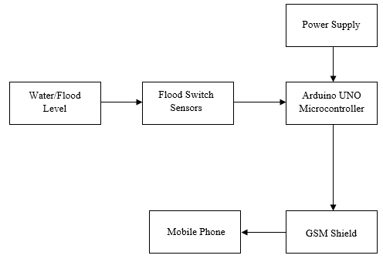
Flow Diagram:

Slide 6
Implementation: (Hardware or software)
HARDWARE:
Arduino Uno
GSM SIM 800 C Module
Water Level Sensor
Connecting Wires
SOFTWARE:
Arduino IDE
Programming Language - C Language

Slide 7
Thank You

